Slide 1


Slide 2

फोहोर मलाई
Presented By: Nikesh Bhandari

Slide 3

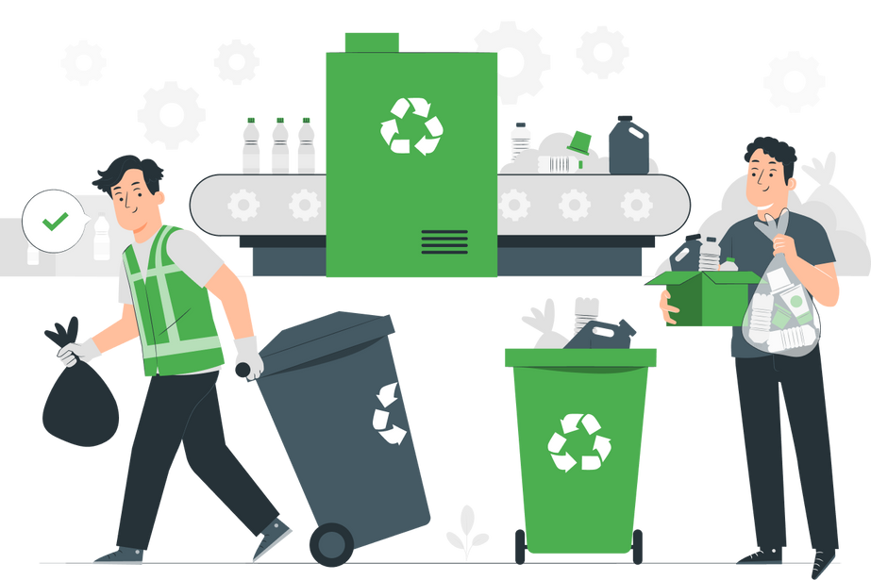
A smart waste management app designed to improve urban waste collection through location-based scheduling, real-time notifications and a marketplace to buy and sell recyclable.
Digitizing the way Nepal manages waste.

Slide 4
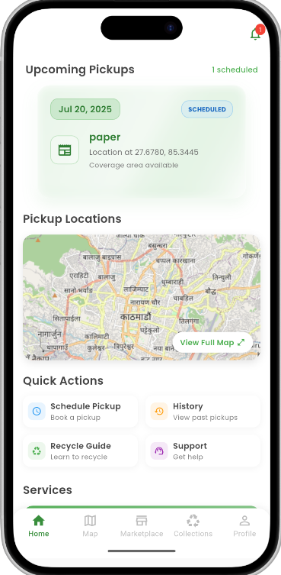
One Solution Platform
Connects households and waste collectors
Provides on-demand and scheduled Pickup options
Marketplace for recyclable materials
Encourage recycling and boosts local economy
Real-time Tracking and Notifications
Enhances transparency and user trust

Slide 5
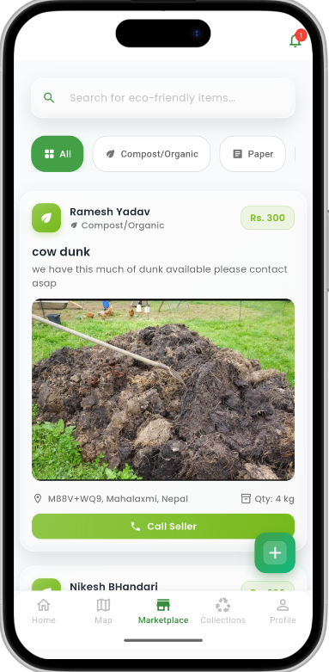
Schedule Pickup
Marketplace
Location-Based Alerts
Request Collection

Slide 6
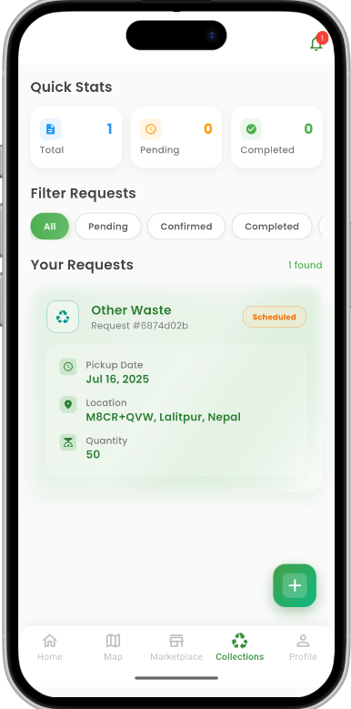
Marketplace
Schedule Pickup
Location-Based Alerts
Request Collection

Slide 7
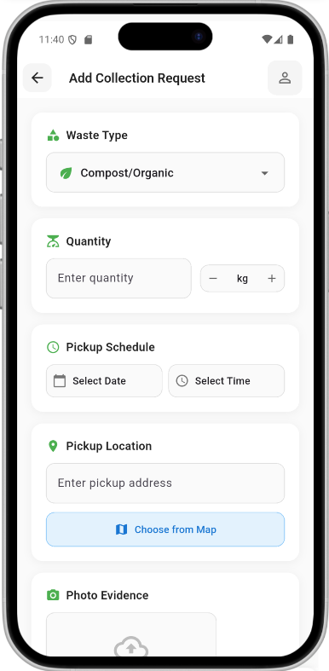
Marketplace
Request Collection
Location-Based Alerts
Schedule Pickups

Slide 8
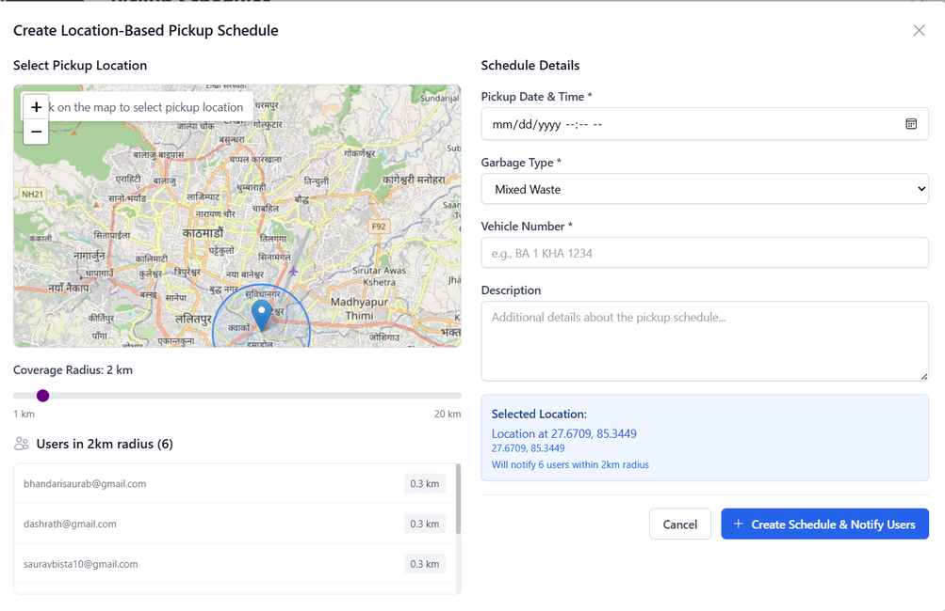
Location-Based Alerts

Slide 9


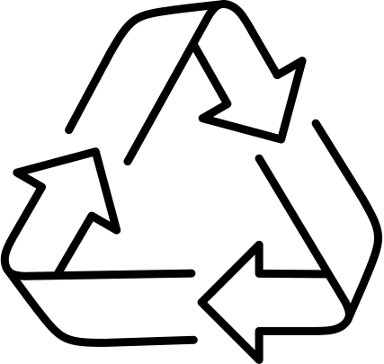
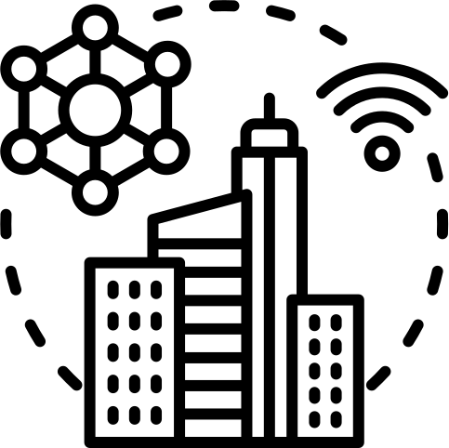

Why
?
Real Problems, Real Users
Community Value
Reusable & Scalable Infrastructure
Missed pickups, illegal dumping, and poor communication are daily issues faced by thousands in Kathmandu
FohorMalai creates a bridge between households and waste collectors, promoting civic responsibility.
The platform can be replicated for any city or municipality in Nepal with minimal adaptation.
Sustainability & Smart City Goals
Government, NGO & Private Use Potential
Supports digital transformation aligned with smart city and eco-friendly policy goals.
Can be pitched to municipalities, environmental organizations, or even sanitation startups.

Slide 10
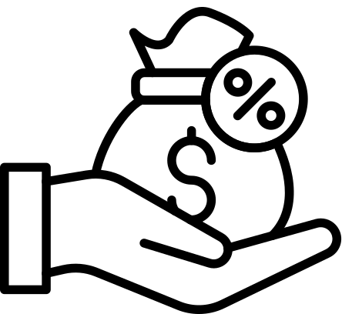

Revenue Model
Marketplace Commission
Government Partnerships

Slide 11
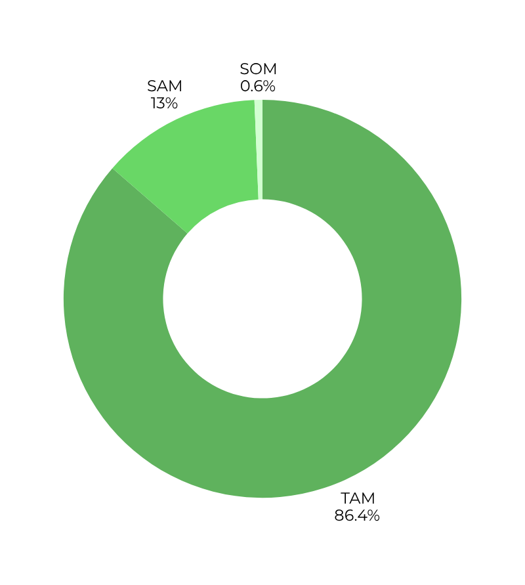
Market Size
Total Adressable Market(TAM)
20-30 Lakhs Household
Servicable Adressable Market(SAM)
3 Lakhs Household
Servicable Obtainable Market(SOM)
15000 Household

Slide 12
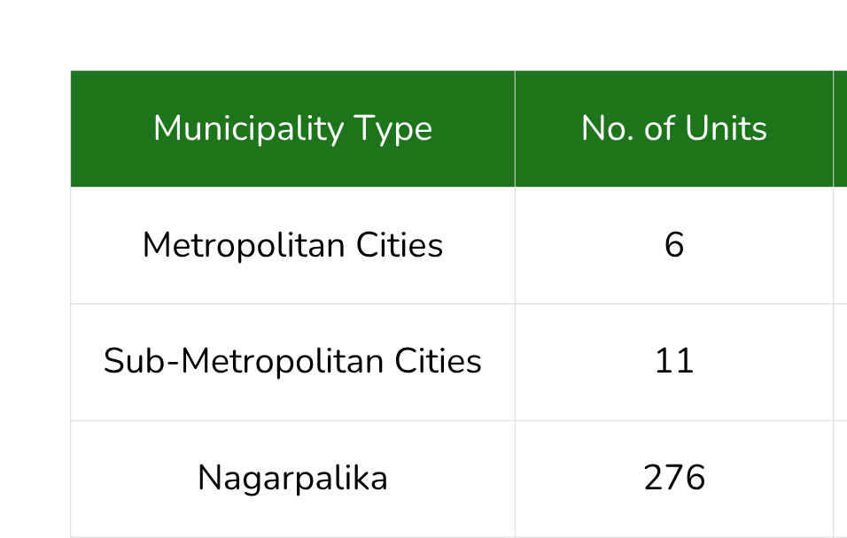
Revenue Potential from Government Partnerships

Slide 13
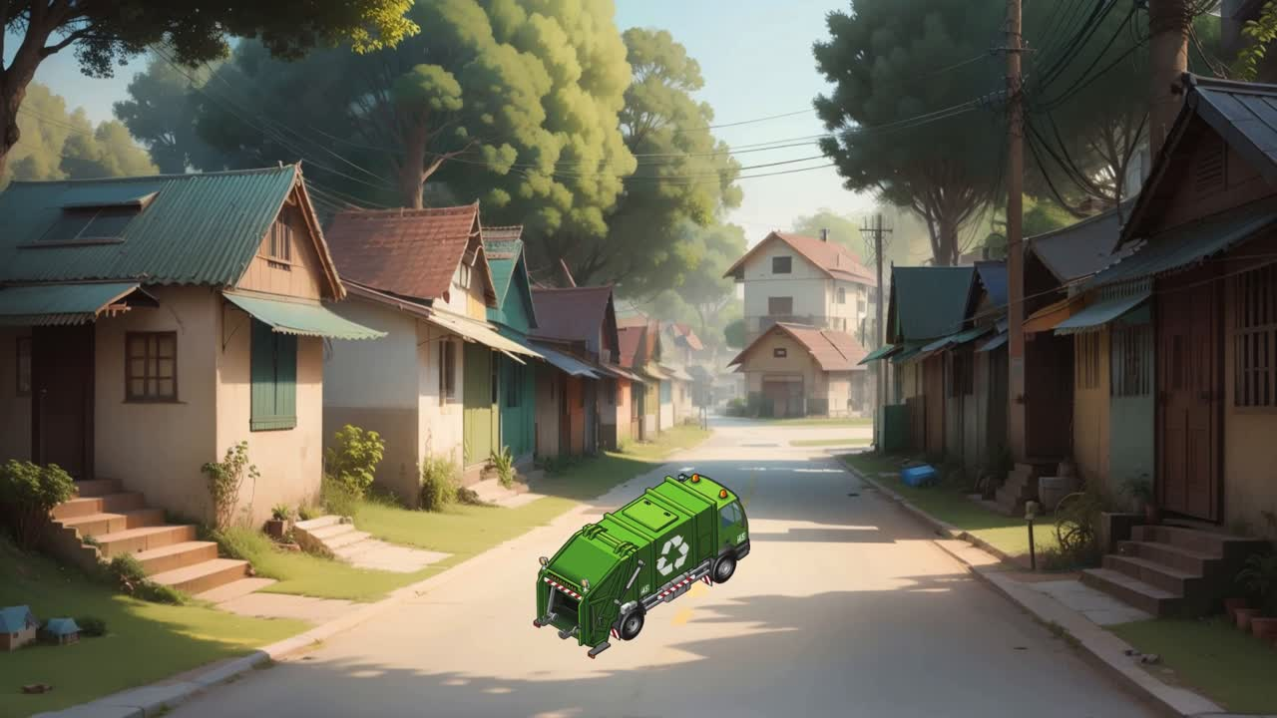

Slide 14
PRODUCT DEMONSTRATION

Slide 15
THANK YOU

